Slide 1

Blood Donation Management System
TEAM MEMBERS
S.HARIHARAN(224027056)
S.KARAN(224027072)
R.RAGUL(224027118)

Slide 2
PROBLEM STATEMENT
The main aim of the project is to save the lives of people by providing blood.
Scarcity of rare blood group.
Unavailability of blood during emergency.
Less awareness among people about blood donation and blood transfusion.
Deaths due to lack of blood during operations.

Slide 3
PROPOSED SYSTEM
This web application contains continuous list of donors and blood bank.
The functionalities of the blood donation can be automated with less man power.
The main aim of the proposed system is to provide an efficient “BLOOD DONATION MANAGEMENT SYSTEM” for people, who will be facing a critical situation to the availability of blood samples.

Slide 4
ADVANTAGES
A blood donation management system streamlines the donor registration process by automating the collection of donor information.
It eliminates paperwork and manual data entry, making the registration process faster and more accurate.
A blood donation management system tracks the inventory of blood units, ensuring efficient storage, retrieval, and distribution.
By maintaining a detailed record of donor screening, testing, and blood component processing, the system ensures compliance with quality and safety standards.

Slide 5
MODULES USED IN THIS PROJECTS
Login Module (Donors, Receiver)
Registration Module
Admin Module

Slide 6
MODULES
RECEIVERS : To register details, request and receive blood from donors.
DONORS : To register details and providing blood to the corresponding receivers.
ADMIN : To manage reports and details.

Slide 7
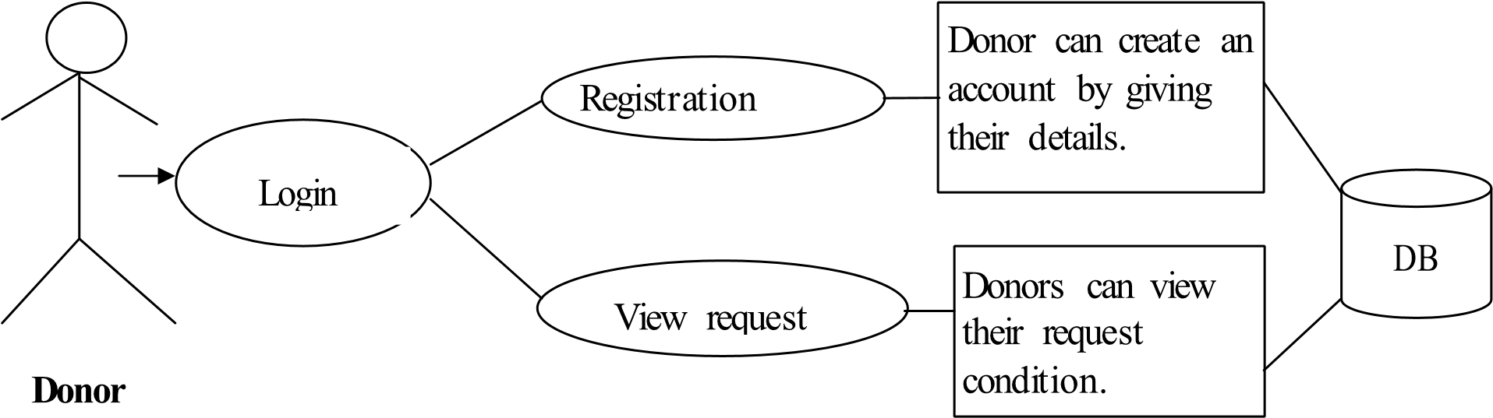
ARCHITECTURE DIAGRAM

Slide 8
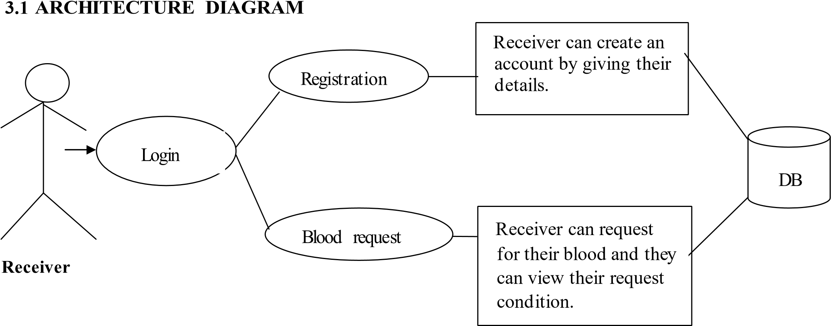
ARCHITECTURE DIAGRAM

Slide 9
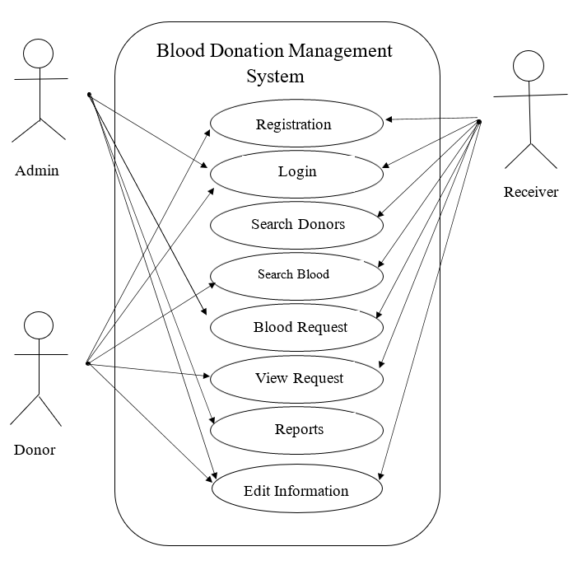
USECASE

Slide 10
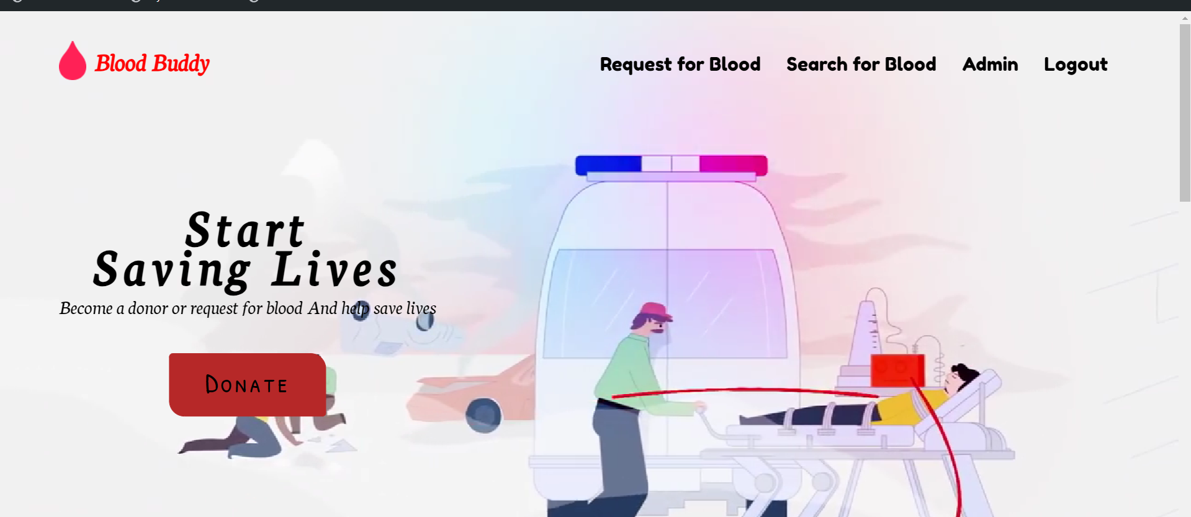
MODULES
INDEX PAGE

Slide 11
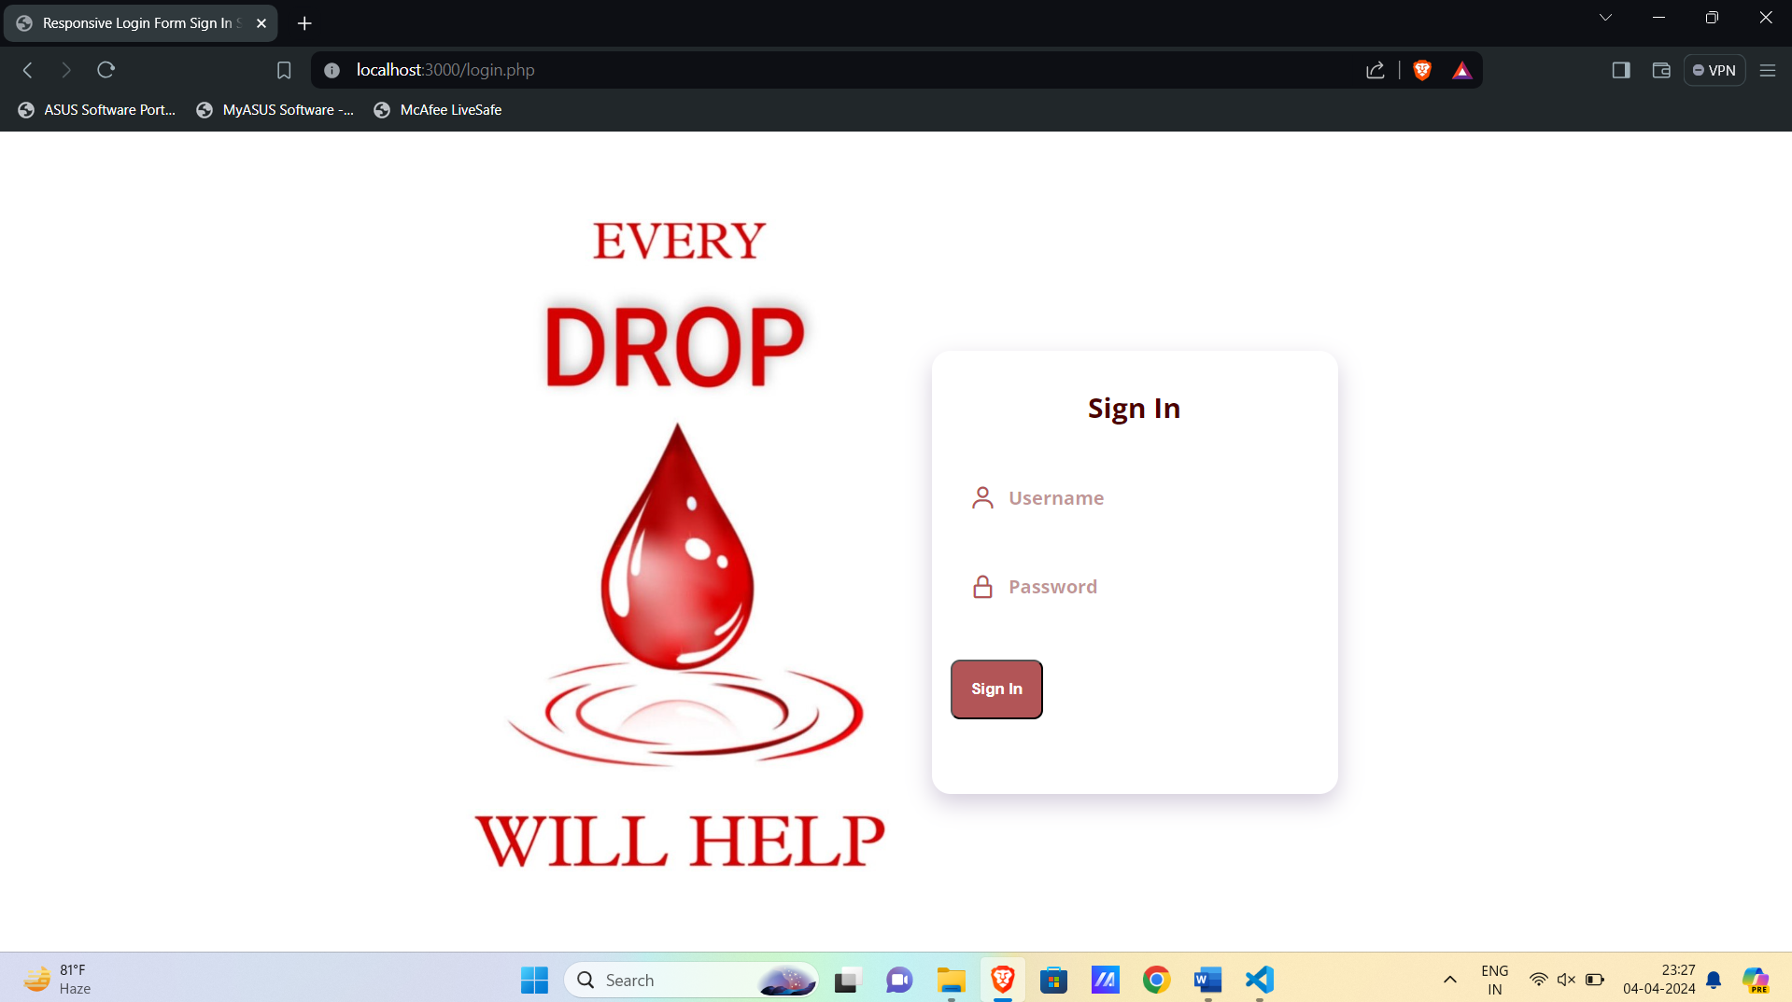
LOGIN
login by giving their id and password.

Slide 12
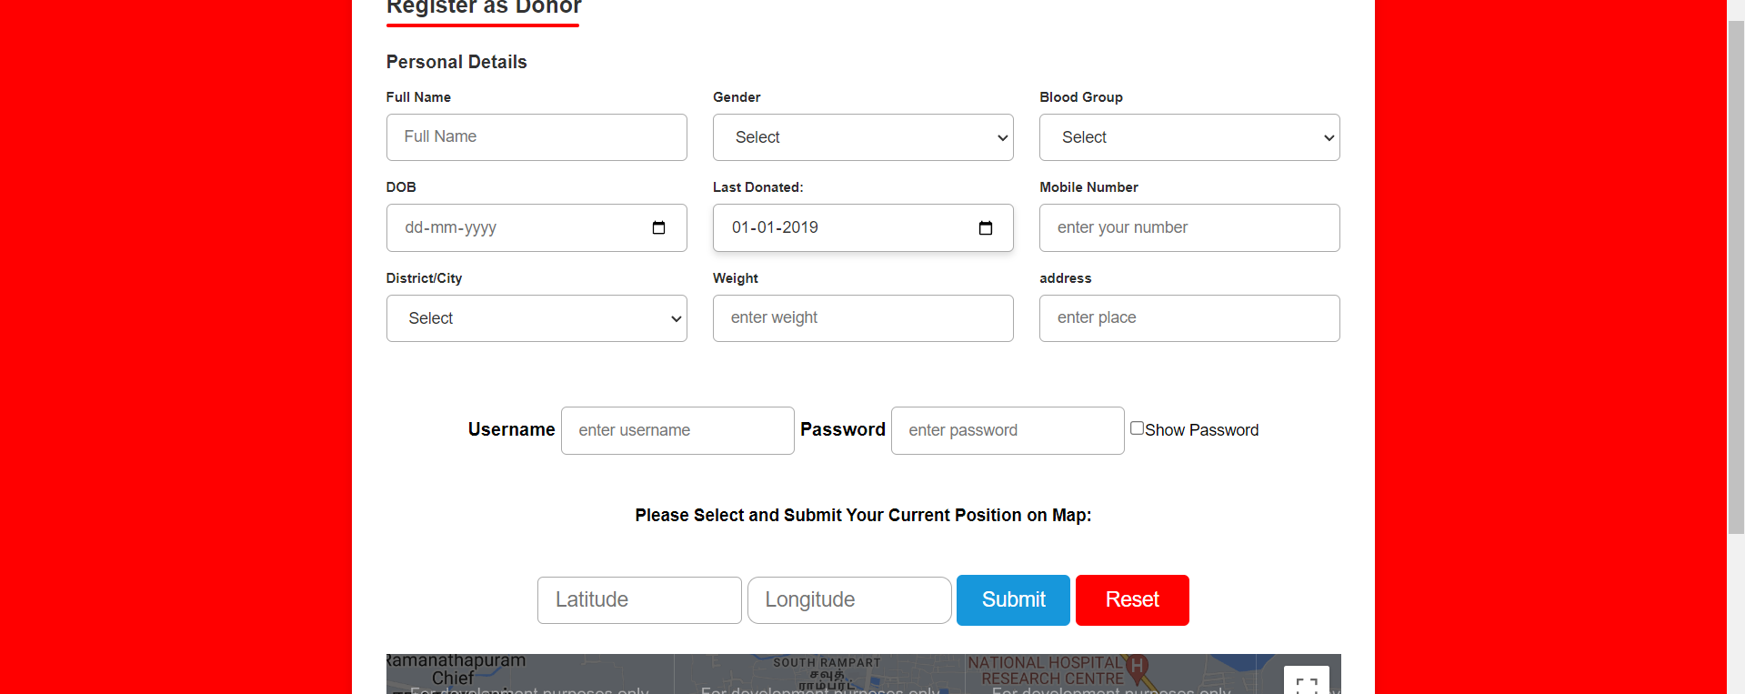
REGISTER
New register can register through this form.

Slide 13
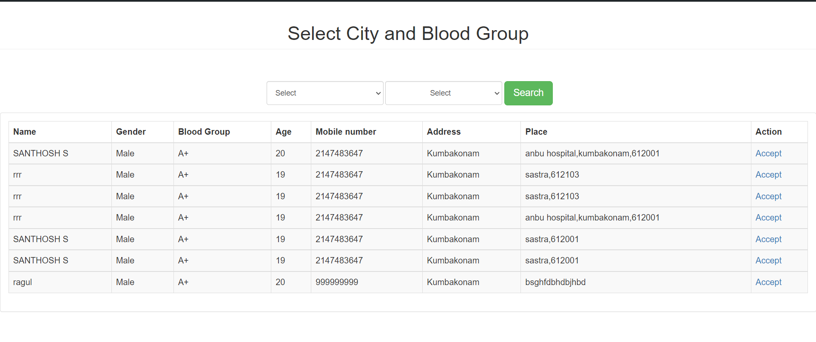
BLOOD REQUEST DETAILS
Requesting Blood by the receiver

Slide 14
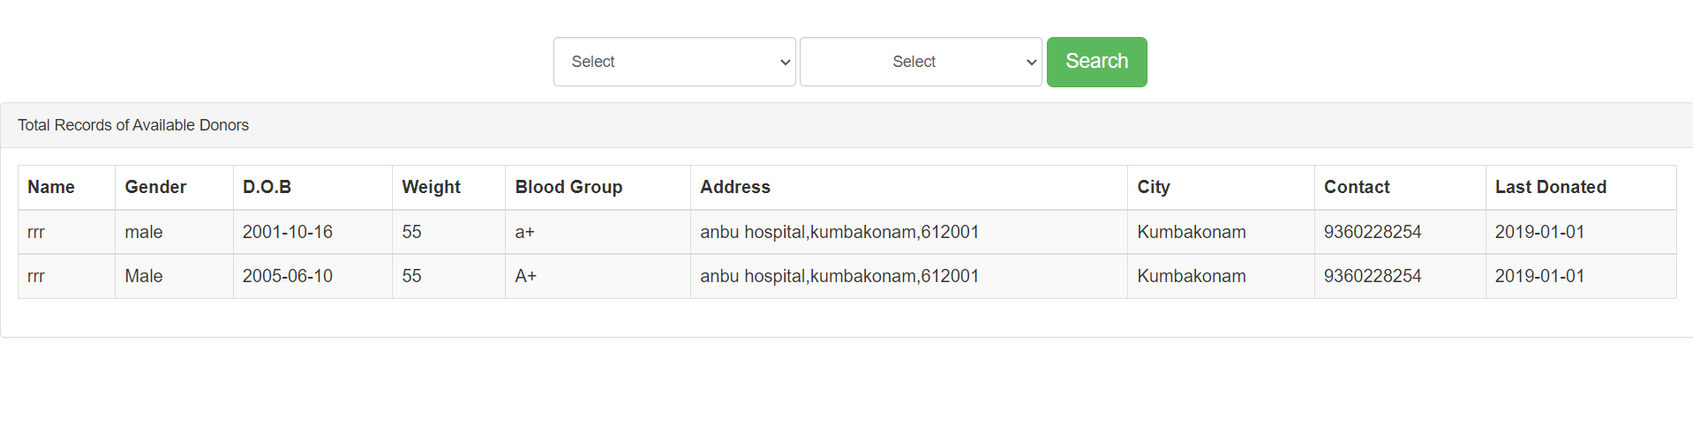
DONOR LIST
Available donors details.

Slide 15
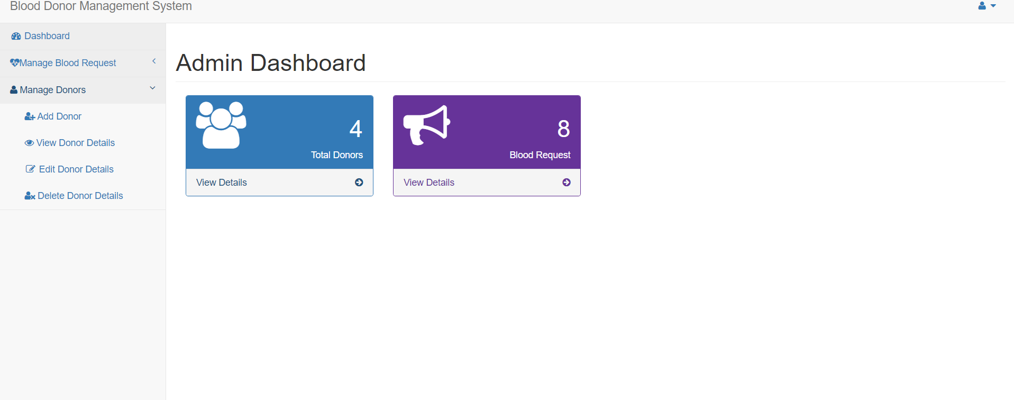
ADMIN PAGE
Admin can modify the details.

Slide 16
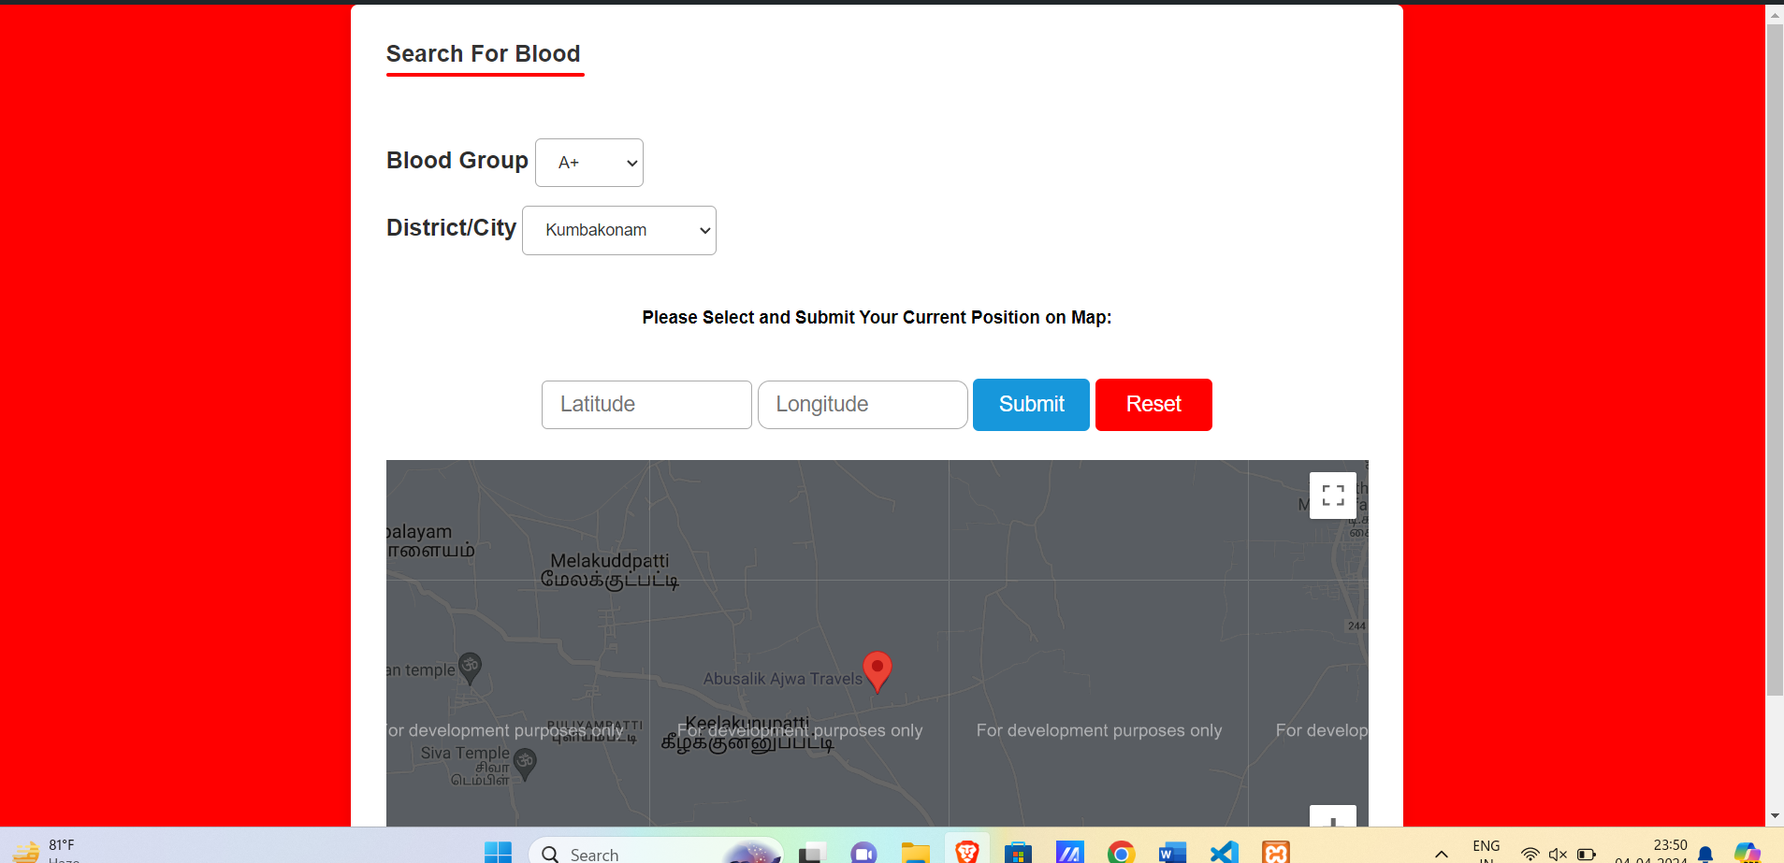
SEARCH FOR BLOOD

Slide 17
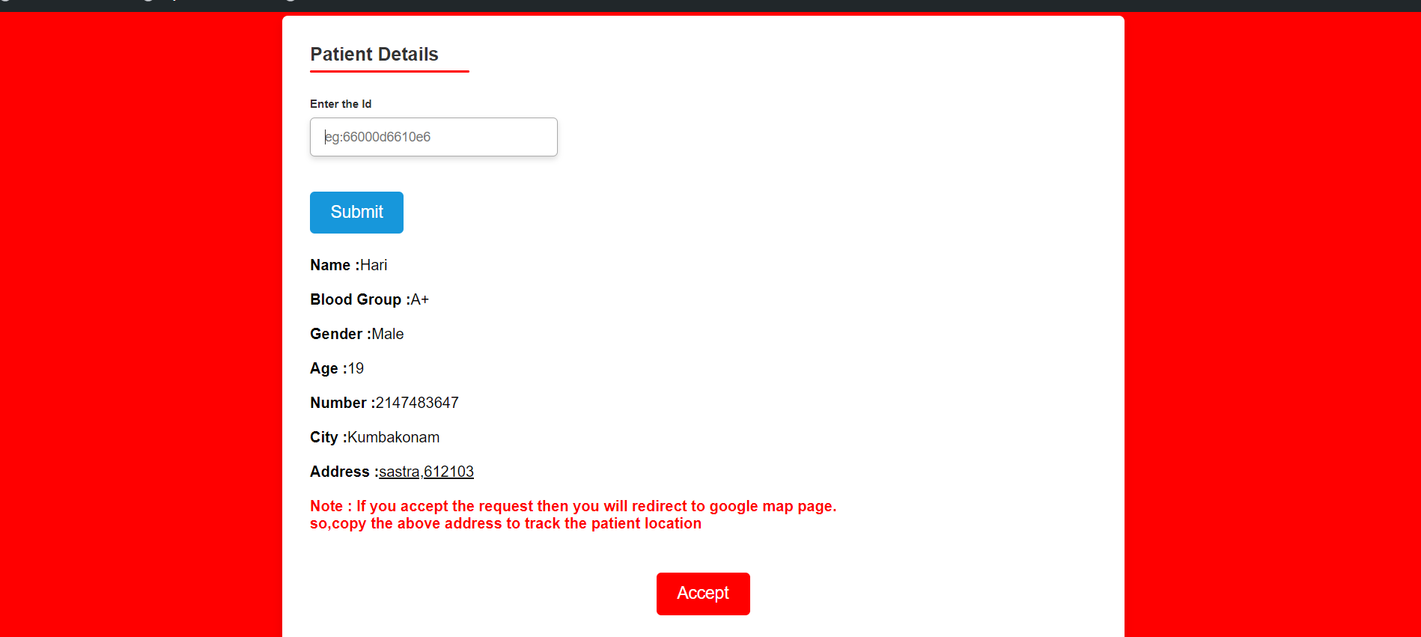
ACCEPTING REQUEST

Slide 18
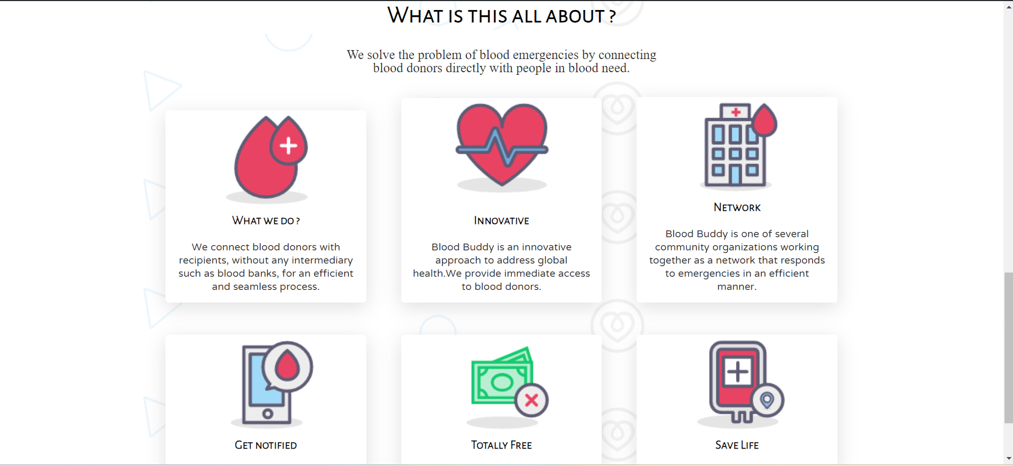
ABOUT US

Slide 19
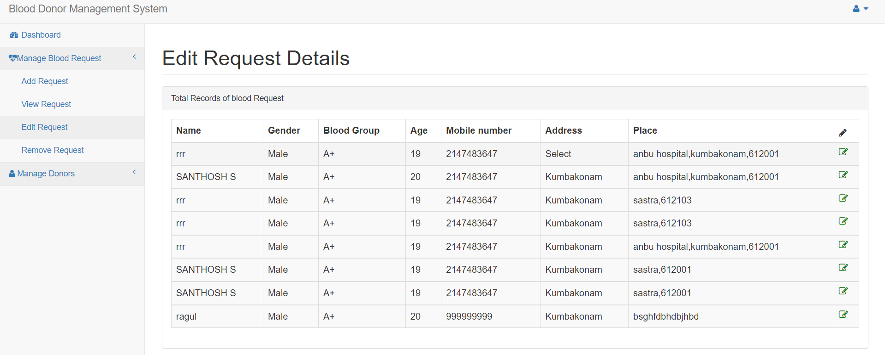
DELETE RECORD
Admin can modify the record.

Slide 20
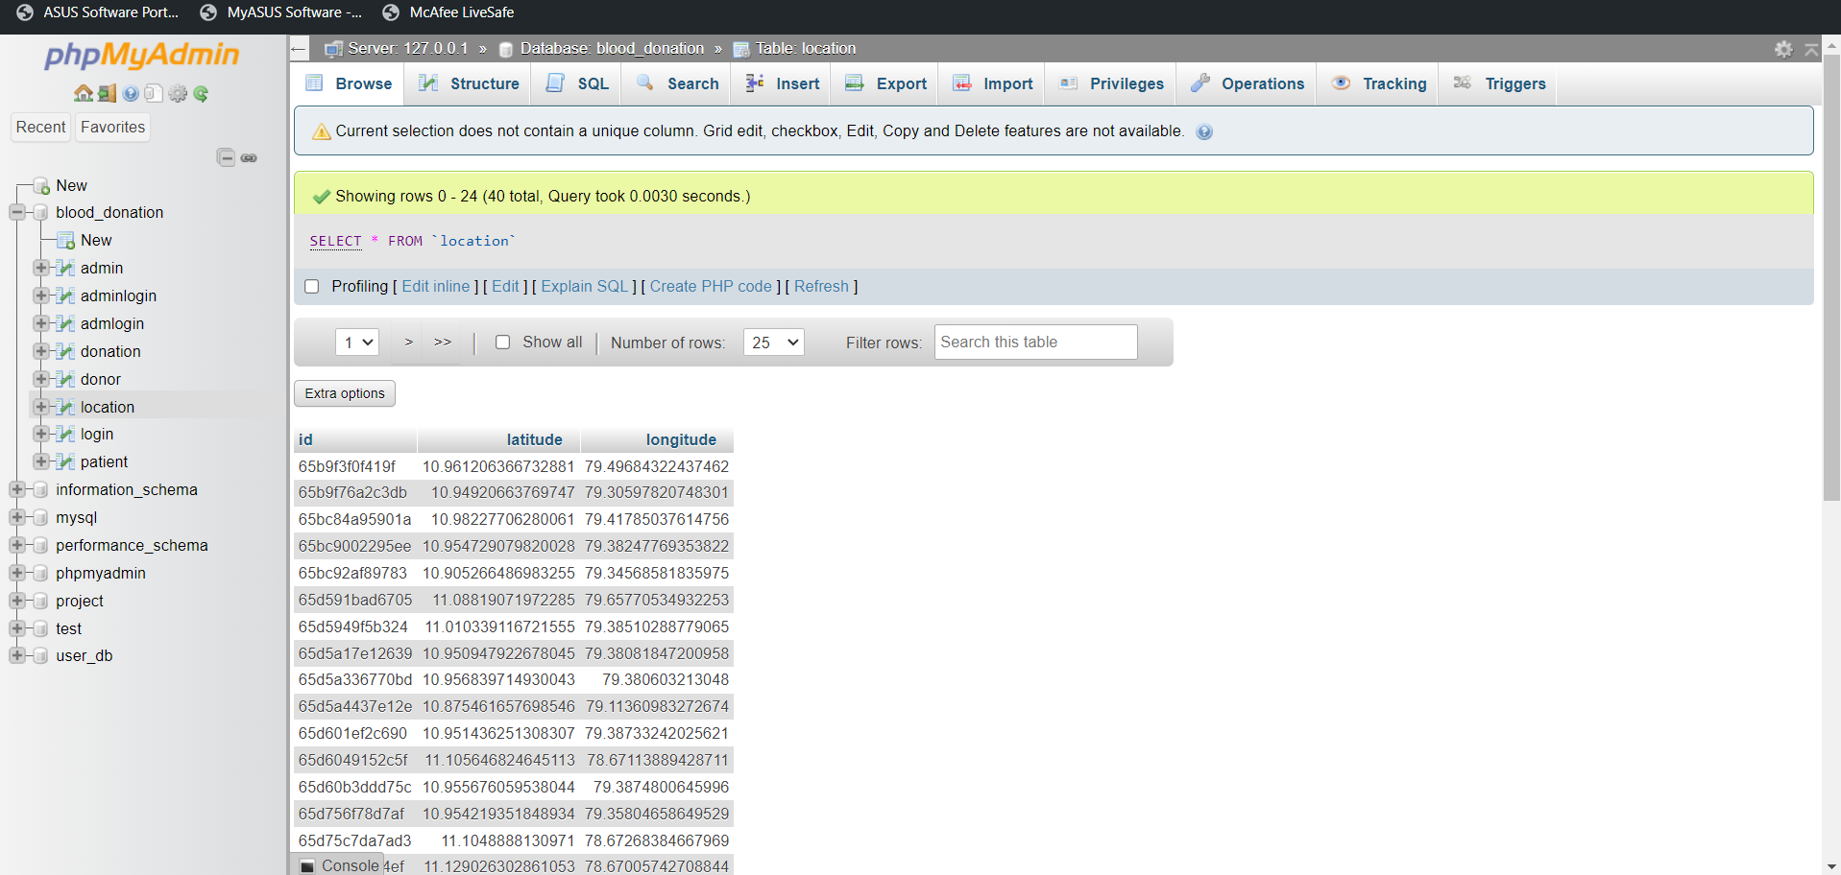
BACKEND

Slide 21
CONCLUSION
From this concept we conclude that this application will help many people to donate and receive blood through online without problem.
This System is easily accessible and easy to use.
Hence this is one of the best alternatives to the Blood Donation Management System.

Slide 22
FUTURE PLANS
In our implementation, we will include the location tracking of the donors and receivers.
At present implemented on a personal system as a web application and it supports only view the requests is accept or not.
And also we like to extend the chat window to help the users to resolve their queries.

Slide 23
THANK YOU

